Slide 1
Epipolar Geometry

Slide 2
Stereo Vision
What is stereo vision?
Why stereo vision?
Applications?

Slide 3
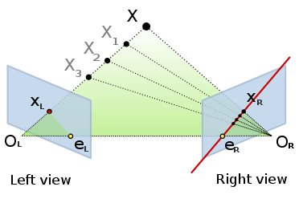
Epipolar geometry
https://en.wikipedia.org/wiki/Epipolar_geometry

Slide 4
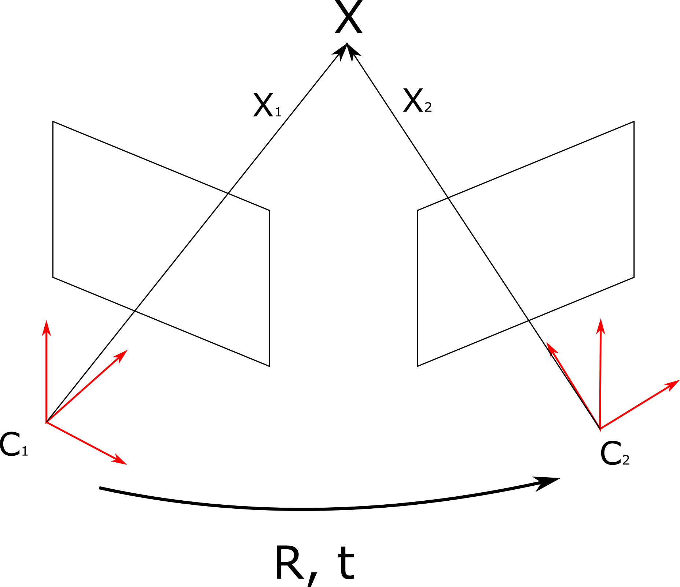
Epipolar geometry

Slide 5
Epipolar constraint
The relationship between the x1 and x2:
Essential matrix:
Fundamental matrix:

Slide 6
Normalized Coordinates
Let’s suppose that the image points are normalized using T1 and T2:
The fundamental of the unnormalized points:

Slide 7
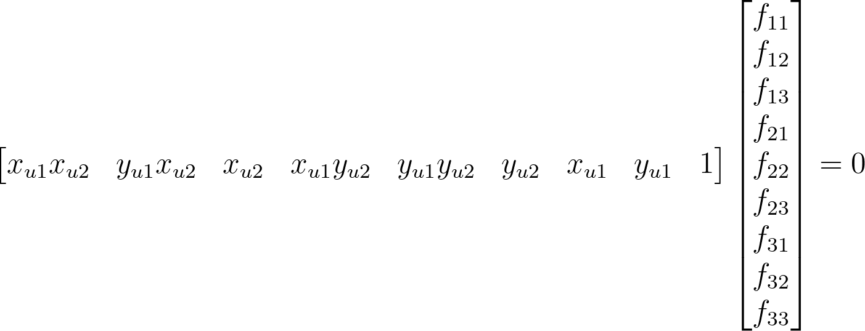
Estimate fundamental matrix
Epipolar constaint:
Transform to homogenous linear system:

Slide 8
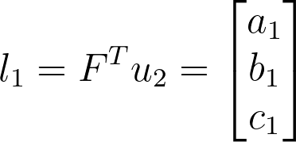
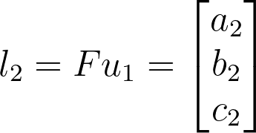
Epipolar lines
The epipolar lines corresponding to the points u1, u2 are given by:
Epipolar distance:
The distance between the epipolar line and corresponding point:
Symmetric epiploar distance:

Slide 9
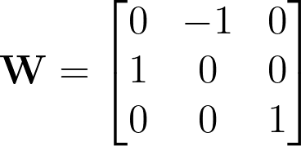
Decomposition of essential matrix
Applying SVD:
Rotations and translations:
Where and u3 is the last column of the matrix U.

Slide 10
Projection matrix
The projection is given as:
where R, t are the extrinsic parameters, and K is intrinsic parameter matrix.

Slide 11
Projection matrix
Considering the first camera is the origin:
The second camera projection matrix:
where R, t are the transformation components from the first to the second camera.
Projection point:
Where X is the spatial point, u1, u2 are corresponding image points in the first and the second image.

Slide 12
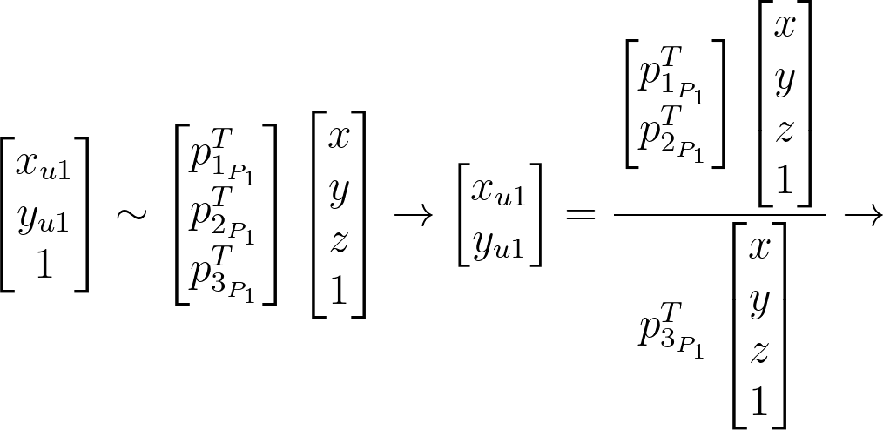
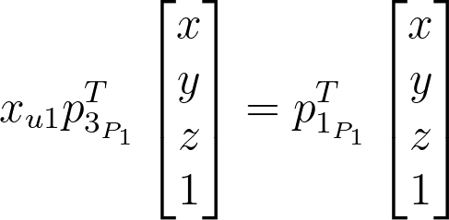
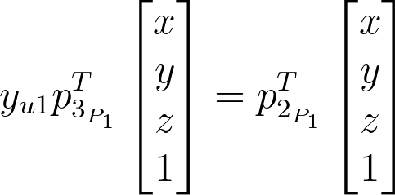
Triangulation
The spatial points could be retrieved using the triangulation:
By reformulating the last two equations and get the last element out from the parameters vector:
The same equation is derived using the second points and the second projection matrix

